Slide 1

Dr. B.C. Roy Engineering College
Chaotic Random Number Generation using MCP4725 I2C DAC & Arduino Due
Name | University roll no
Abir Dey | 12000322092
Arka Dip Halder | 12000322108
Samannoy Shome | 12000322084
Under the guidance of
Dr. Anup Kumar Das

Slide 2
Motivation
Random Number Generation (RNG) is a key component in many electronics and embedded systems applications — from simulations and secure communication to signal processing and procedural content generation. When combining Arduino Due with MCP4725 DAC, the system can be used not just for digital computation but also for analog signal control and randomness visualization.

Slide 3
Content
Contents | Slide No.
Abstract | 4
Literature Review | 5
Proposed Work | 6
Methodology | 7
Components Used | 8
Proposed Circuit | 9
Results and key notes | 10-12
Conclusion & Future works | 13
References | 14

Slide 4
Abstract
This project explores random number generation using the Arduino Due and the MCP4725 Digital-to-Analog Converter (DAC). The Arduino Due collects analog entropy from noise sources (e.g., floating pins) to seed a pseudo-random number generator. These random values are then converted to analog signals using the MCP4725 DAC. This system allows for real-time visualization of randomness in analog form, enabling applications in signal simulation, noise testing, and embedded cryptographic systems. The setup provides a low-cost, effective solution for combining digital randomness with analog output.

Slide 5
Literature Review
Year | Title / Source | Focus | Key Findings
2024 | Chaos-Based Bitwise Dynamical PRNG on FPGA – Garcia‑Bosque et al. (arxiv.org) | Logistic map with dynamic parameter modulation in FPGA | Achieved 98.9% pass rate on NIST tests; shows logistic-based PRNGs can be hardware-efficient and test-strong.
2024 | Logistic Map PRNG in FPGA – Calderon et al. | FPGA implementation + Central Limit transform | Generated Gaussian-like distributions suitable for DAC back-end (e.g., MCP4725) visualization.
2024 | Modification of Intertwining Logistic Map – Symmetry Journal | Efficient 3D logistic map for CPU/FPU | Improved speed and secured NIST/DIEHARD compliance—suitable for embedded systems like Arduino Due.
2022 | Siponi Map DT Chaos-Based RNG – Magfirawaty et al. | Novel 1D map variant on FPGA | Passed NIST/DIEHARD without post-processing; processed positive/negative values.
2021 | Deep‑Zoom Composition of Logistic & Tent Maps – Alvarenga et al. | Mix of maps with digit truncation (“deep-zoom”) | Improved randomness; suitable for cryptographic use on microcontrollers.
2021 | Turbulence‑Padded Chaotic Map PRNG – Krishnamoorthi et al. | Logistic base with turbulence padding | Achieved larger key space, +5% speed, passed NIST SP 800‑22 with logistic seed.

Slide 6
Proposed Work
This presentation explores chaotic random number generation. We use an MCP4725 DAC and Arduino Due. This creates unpredictable numbers via chaotic systems. It has applications in cryptography, simulations, and art. Random number generation using hardware like the MCP4725 DAC (Digital-to-Analog Converter) with an Arduino Due can be a clever way to produce analog noise signals, which may be used to seed a pseudo-random number generator (PRNG).

Slide 7

Methodology
Chaotic Map Implementation
The logistic map equation is used. We set 'r' to 3.99 for chaotic behavior. This creates non-repeating patterns.
Arduino Due Calculation
MCP4725 Analog Output
The Arduino Due performs all calculations.
It generates the x(n) values.
These are mapped to analog outputs.
The MCP4725 outputs analog voltage.
This voltage is proportional to x(n).
The sampling rate is 10 kHz.

Slide 8

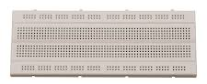
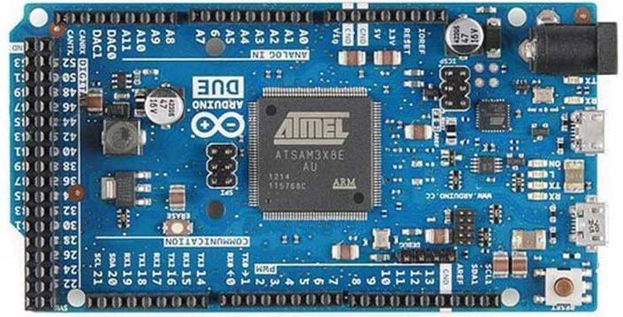
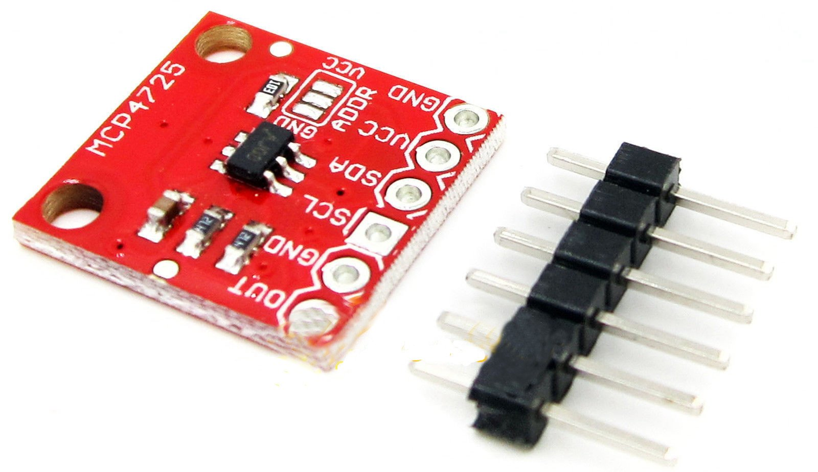
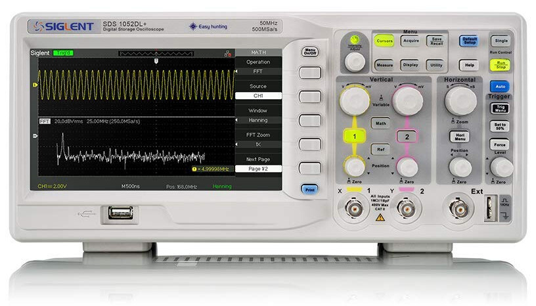
Components Used
Component | Quantity
Arduino DUE | 1
MCP4725 DAC | 1
Breadboard | 1
Jumper Wires | 1 set
Oscilloscope | 1 (optional but useful)
Jumper Wires
BreadBoard
Arduino DUE
MCP4725 I2C DAC
Oscilloscope

Slide 9
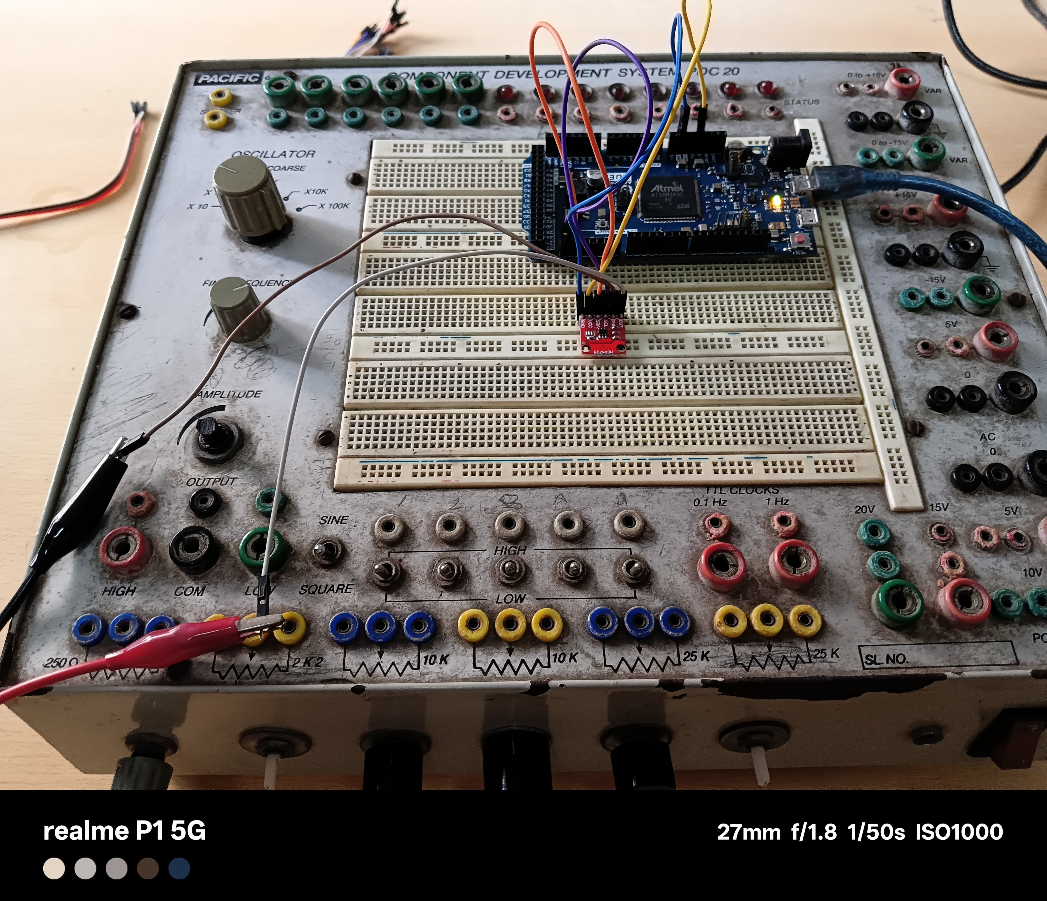
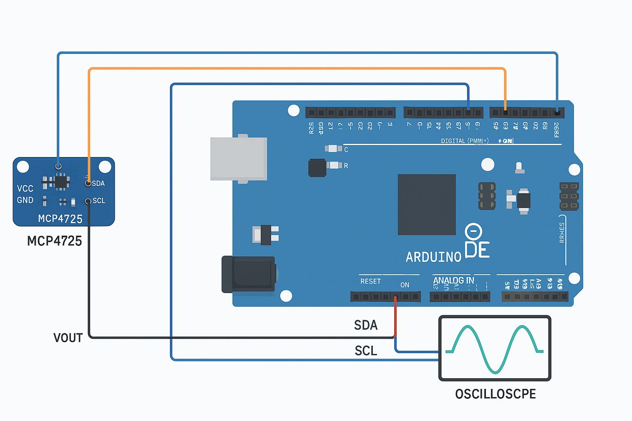
Proposed Circuit
🔌 Circuit Connection (Wiring):
MCP4725 Pin | Connects to Arduino DUE
VCC | 3.3V or 5V
GND | GND
SDA | Pin 20 (SDA)
SCL | Pin 21 (SCL)
VOUT | Output to oscilloscope or analog device

Slide 10
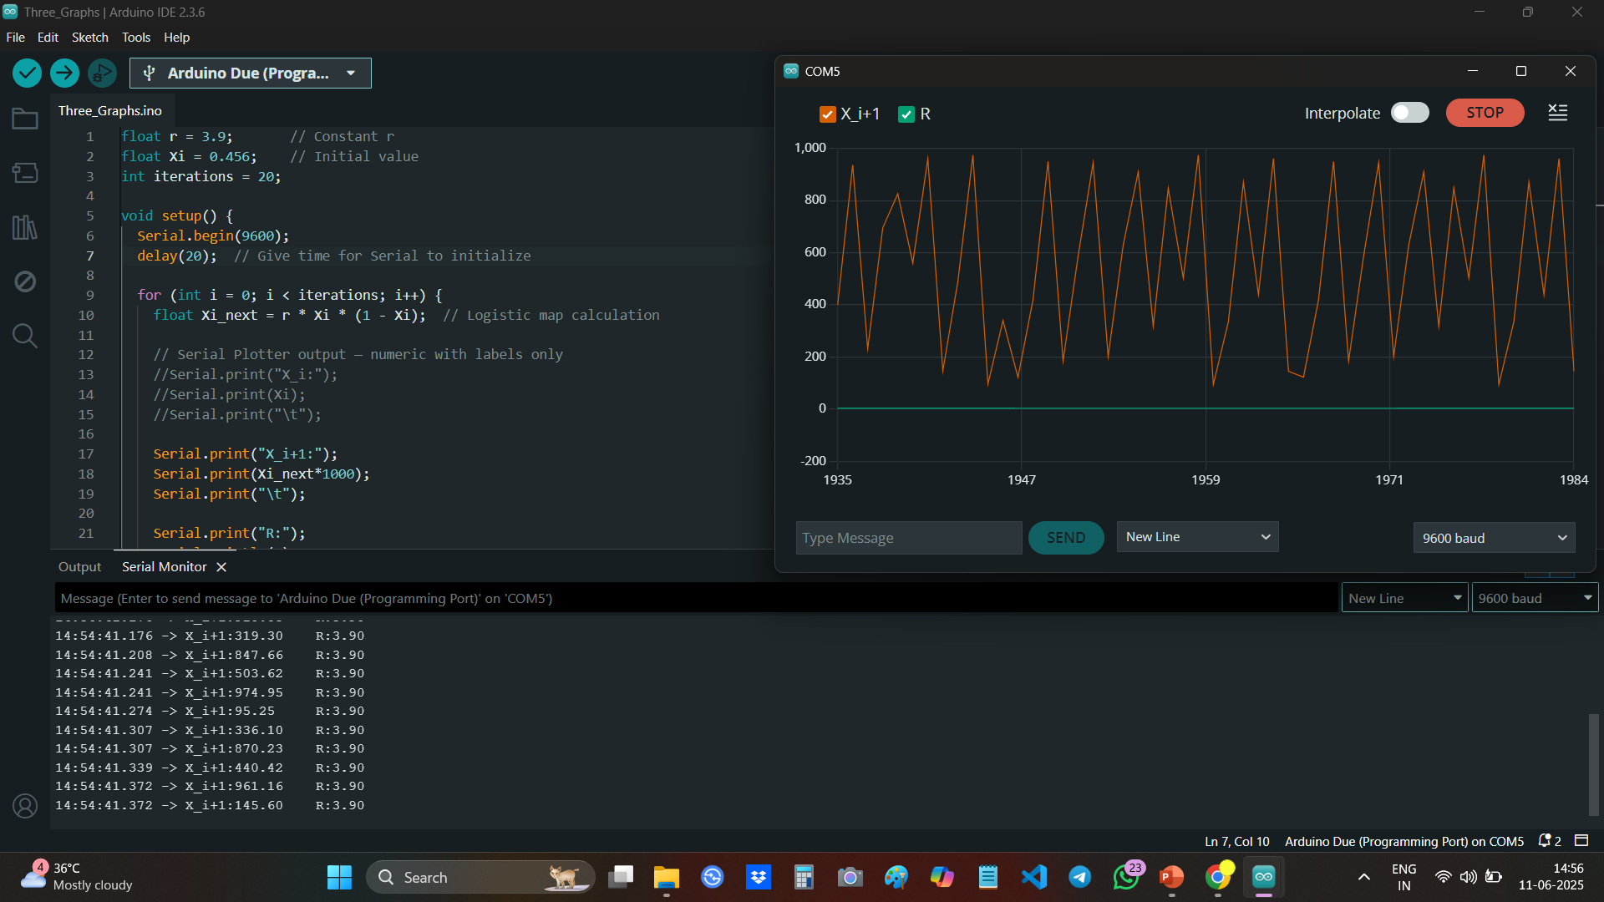
Result
Mathematical Formula Used:
Xi+1=r⋅Xi⋅(1−Xi)
Where:
Xi is the current value (initially 0.456)
r is the control parameter (in your case, 3.9)
Xi+1​ is the next value in the sequence
Output is scaled: Xi+1×1000 (to fit DAC range or for better plotting)
How It’s Calculated (Example):
Let’s take the first value:
X₀ = 0.456
r = 3.9
X1 = 3.9*0.456*(1−0.456)=0.9695*1000 → Scaled: 969.5

Slide 11
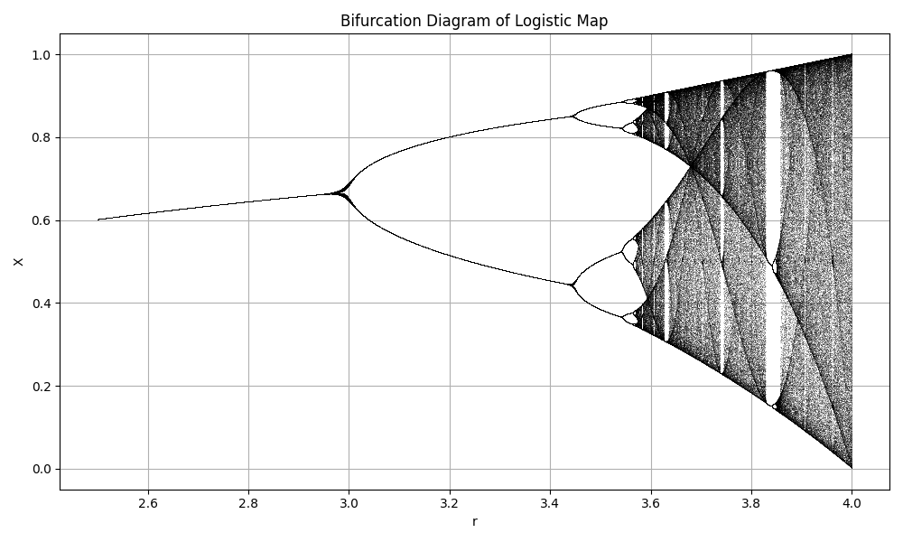
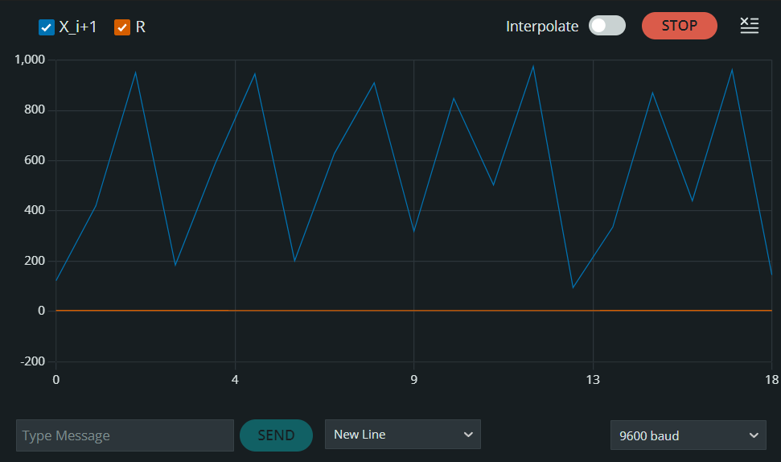
Here is the table showing all 20 iterations of the logistic map equation:
Logistic Map Iteration Table (r = 3.9, X₀ (Initial value)= 0.456)
Iteration (i) | Xi | Xi+1=r⋅Xi⋅(1−Xi)
0 | 0.456000 | 0.969446
1 | 0.969446 | 0.115366
2 | 0.115366 | 0.398249
3 | 0.398249 | 0.934873
4 | 0.934873 | 0.236433
5 | 0.236433 | 0.704164
6 | 0.704164 | 0.811586
7 | 0.811586 | 0.596169
8 | 0.596169 | 0.939343
9 | 0.939343 | 0.221534
10 | 0.221534 | 0.673739
11 | 0.673739 | 0.857003
12 | 0.857003 | 0.476229
13 | 0.476229 | 0.974159
14 | 0.974159 | 0.097771
15 | 0.097771 | 0.344024
16 | 0.344024 | 0.879369
17 | 0.879369 | 0.416822
18 | 0.416822 | 0.950070
19 | 0.950070 | 0.184321

Slide 12
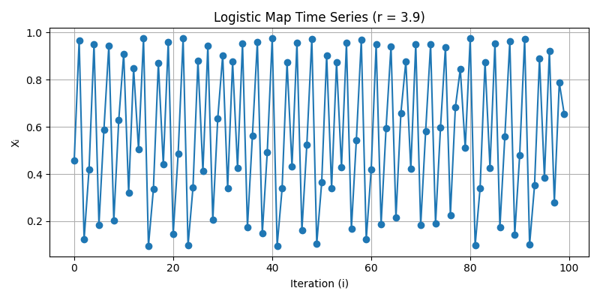
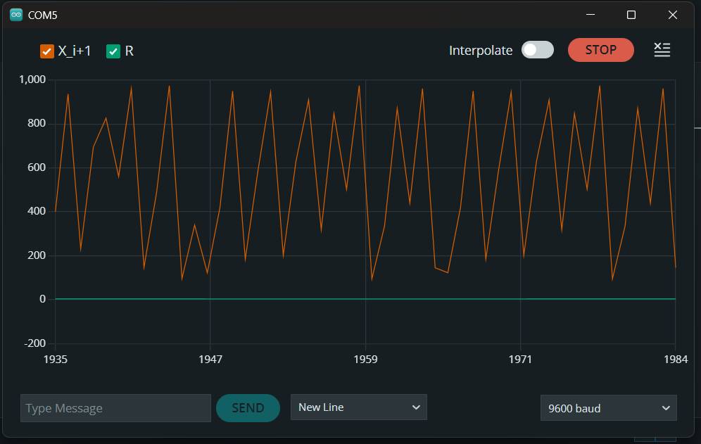
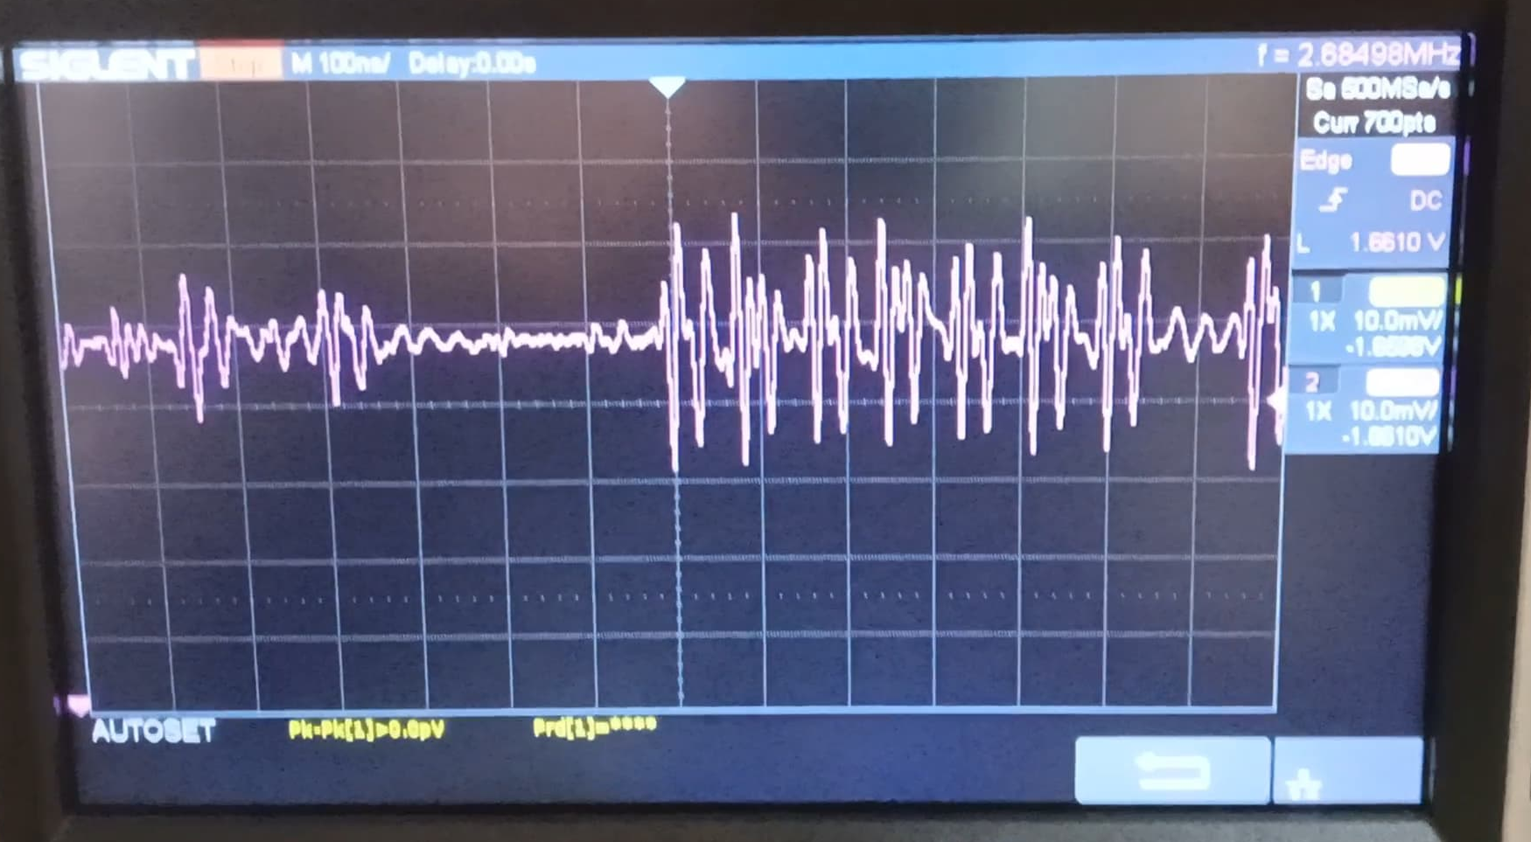
Key Graphs and Data Visualizations
Logistic Map Time series (Xi/r) graph
Output from CRO & Serial Plotter

Slide 13
Conclusion & Future Work
In this project, we successfully implemented a chaotic random number generator using the logistic map algorithm on an Arduino Due and converted its digital output to analog form using the MCP4725 DAC. The chaotic behavior was demonstrated through the unpredictable and non-repeating nature of the output sequence, generated via the mathematical model:
with r= 3.9, a value known to produce chaotic dynamics.
By demonstrating both mathematical theory and hardware execution, this project highlights how low-cost microcontrollers and peripherals can be used to explore complex nonlinear systems and generate randomness for practical applications.
This experiment also opens up further scope for enhancement, such as:
Using the Arduino Due’s hardware True Random Number Generator (TRNG) as entropy input.
Combining multiple chaotic maps for greater complexity.
Feeding analog output into external systems for real-time cryptographic or audio applications.

Slide 14
Reference
References | URLs
Gupta, S., Goswami, U., & Kohli, N. (2018). Highly Chaotic RNG Based on Logistic Map. IJERT. | PDF: 10.17577/IJERTV7IS050078
Wang, L. & Cheng, H. (2019). Pseudo‑Random Number Generator Based on Logistic Chaotic System. Entropy, 21(10), 960. | PMCID: PMC7514290
Phatak, S. C., & Rao, S. S. (1993). Logistic Map: A Possible Random‑Number Generator. | Click Here
Yu, X. (2019). A Survey on True Random Number Generators Based on Chaos. Discrete Dynamics in Nature and Society, 2019, 2545123 | Open
Applied Sciences (2021). Hybrid Chaotic‑Based PRNG for Secure Cryptography | Website link

Slide 15



THANK YOU
THANK YOU

